Slide 1
Credit Card Customers – Predict Future Campaign

Slide 2
Overview
The dataset for this project was obtained from an anonymous Financial institute that provides loans for individuals.
Objective is to develop customer segmentation as a means to defining marketing strategy for the next campaign.

Slide 3
Problem Statement
Can the bank’s next campaign be based on Customer segmentation?
What Clustering model would best predict based on Customer segmentation?
Which model most accurately predicts the segmentation?

Slide 4
Background
Found on Kaggle:
https://www.kaggle.com/ainslie/credit-card-data-clustering-analysis
Data was collected from 9000 active credit card holders
The file is customer level with 18 behavioral variables
Notes:
Moving from research question to some kind of hypothesis -- you want to use logic, theory and prior empirical evidence to move toward some hypotheses you can test. This is why domain expertise cannot be overlooked among data scientists.

Slide 5
Why care about Smartphone Sensor?
Given the rising healthcare costs, and the current pandemic situation, makes things tougher for the patients with chronic conditions.
Smartphones are increasingly common around the world and are incorporating more inertial sensors such as accelerometers, gyroscopes, and magnetometer.
This makes smart phones an ideal tool to reach a large section of the population and is not as restricted by location or battery life.
Notes:
Moving from research question to some kind of hypothesis -- you want to use logic, theory and prior empirical evidence to move toward some hypotheses you can test. This is why domain expertise cannot be overlooked among data scientists.

Slide 6
From Data to Modeling
All data is of numerical data type
A few columns have outliers
Missing fields to be filled with the mean of each column
Notes:
Moving from research question to some kind of hypothesis -- you want to use logic, theory and prior empirical evidence to move toward some hypotheses you can test. This is why domain expertise cannot be overlooked among data scientists.

Slide 7
Feature Engineering
Focus on outliers since many of the columns in our dataset have outliers
Have different groups of columns with similar data types and even ranges, and binning these columns will help us cluster the data
Setting the bin ranges will help prevent the loss of data points since binning emphasize the difference that we have in mind to the algorithm
Notes:
Moving from research question to some kind of hypothesis -- you want to use logic, theory and prior empirical evidence to move toward some hypotheses you can test. This is why domain expertise cannot be overlooked among data scientists.

Slide 8
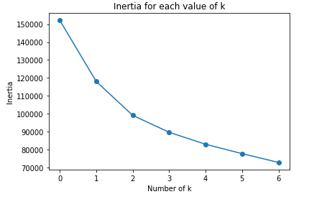
Clustering - KMeans Balance
Six clustsers seems to have the most coherent distribution of data points
Notes:
Moving from research question to some kind of hypothesis -- you want to use logic, theory and prior empirical evidence to move toward some hypotheses you can test. This is why domain expertise cannot be overlooked among data scientists.

Slide 9
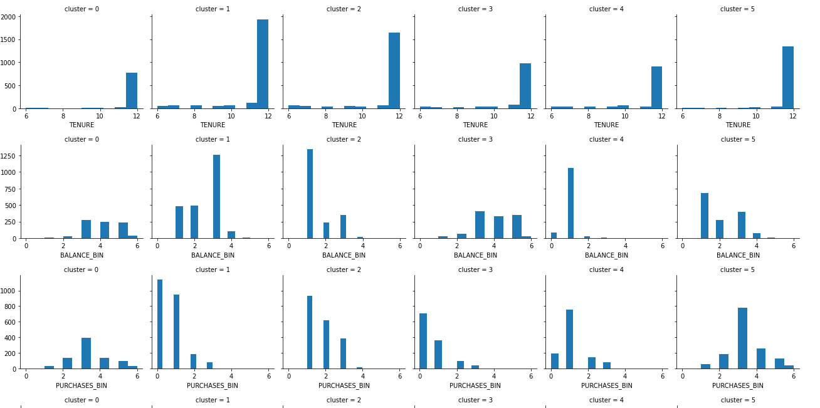
Visualization of Cluster Features
Notes:
Moving from research question to some kind of hypothesis -- you want to use logic, theory and prior empirical evidence to move toward some hypotheses you can test. This is why domain expertise cannot be overlooked among data scientists.

Slide 10
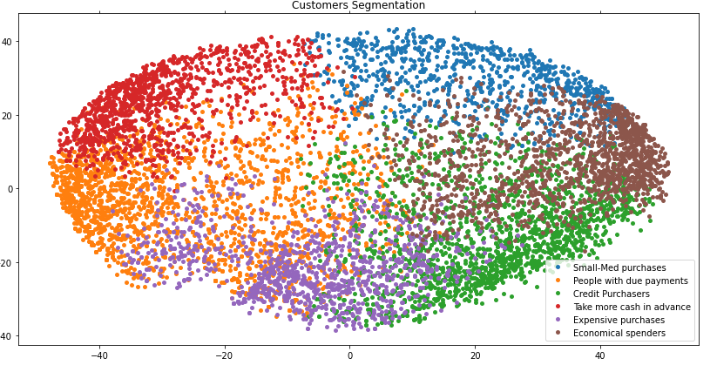
Visualize Clusters with PCA – Isotropic Shape
Higher up we go in the y-axis, the more credit these clusters are availing
Notes:
A statistical method is not a story, but we can tell a story from the statistics. For example, using confidence intervals we can put into dollars what we think would happen if we make some business move, given the data that we have.
The words “t-test,” “normality,” “independent samples” etc did not come up at all in this explanation! Although someone who does know about this stuff can still have confidence in the results with the way you have laid out the story and the quantifiable results.

Slide 11
Mean Shift and Affinity Propogation
Mean Shift – Number of estimated clusters → 1
- Number of estimated clusters is certainly not 1. Furthermore, logically we can’t expect customers to have uniform behavior given almost any community regardless of the size.
Affinity Propagation – Number of estimated clusters → 44
- It is common for Affinity Propagation to overestimate the number of clusters, which is the case in our data.
Notes:
A statistical method is not a story, but we can tell a story from the statistics. For example, using confidence intervals we can put into dollars what we think would happen if we make some business move, given the data that we have.
The words “t-test,” “normality,” “independent samples” etc did not come up at all in this explanation! Although someone who does know about this stuff can still have confidence in the results with the way you have laid out the story and the quantifiable results.

Slide 12
Conclusion
Kmeans is most widely used in Clustering may not be because it works every time, but probably due to its logical handling of data and logical output of clusters.
No need to evaluate MeanShift and Affinity Propagation model clusters due to the cluster output being absurd and illogical.
Kmeans performed much better and gave output that could be interpreted easily by businesses, human, and this generate value for a Marketing manager trying to look at a high-level segmentation of their company’s customers.
If I need a model with accurate predictions, then I would choose SVM because it was able to achieve the highest average accuracy of 0.96
Furthermore, I want to create more explanatory models because it would help data scientist and engineers design better machines and models that focus on these important distinctions between activities
Notes:
https://unsplash.com/photos/OX_en7CXMj4
Then we want to move to recommendations, what is the call to action? What should your audience do now that they know what you have told them?

Slide 13
Questions?

Slide 14
Thank You

